Slide 1



UAttended
Attendance Checker Based On
Face Recognition
Hsin-Ting Hsieh
Theresia Baier
Yuxin Wang
29/07/2020
Notes:
Yuxin

Slide 2

Contents
Show Time!
UAttended Demo
Techniques & Methodology
01
02
Implementation
Conclusion & Outlook
03
04
The user journey of generating an attendance list
Face recognition methods & tools, GPU, API
Preparation, training, application, evaluation, deployment
Summary, reflection & further work
Notes:
Yuxin

Slide 3
Show Time!
UAttended Demo
01
The user journey of generating an attendance list
Notes:
Hsin-Ting

Slide 4

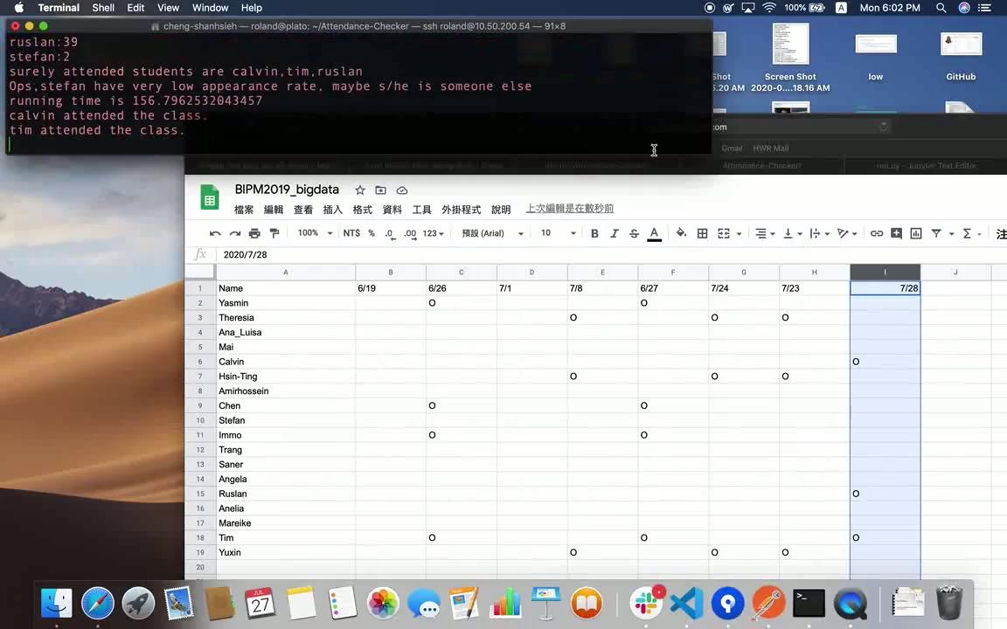
Notes:
Hsin-Ting

Slide 5

Motivation
Attendance Check Is Everywhere
Attendance Check Is Everywhere
Online Learning Rises Up Dramatically
Online Learning Rises Up Dramatically
Filling-in Attendance List Is Forgettable
- An important action to evaluate students’ dedication, the popularity of lectures/events
Schools, companies, events all need attendance check
- An important action to evaluate students’ dedication, the popularity of lectures/events
Schools, companies, events all need attendance check
- Over 1 billion students (pre-primary to tertiary) were affected due to COVID-19
- More and more distant learning programs
- Over 1 billion students (pre-primary to tertiary) were affected due to COVID-19
- More and more distant learning programs
- Check-in in Excel every time for each lecture adds administrative efforts to professors and students
- Too many topics to focus on to remember check-in every time
Notes:
Hsin-Ting

Slide 6
Techniques
& Methodology
02
Face recognition methods & tools, GPU, API
Notes:
Theresia

Slide 7
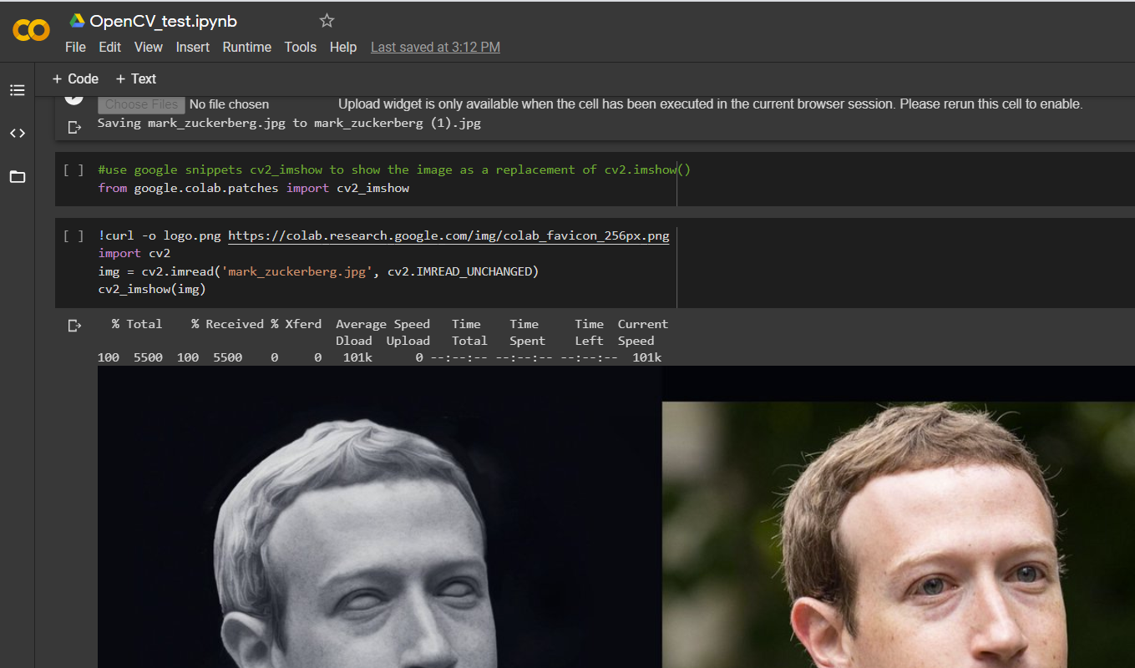
Working Environment
Google Colaboratory
Development
Environment
Language
Python
GPU
16GB memory
Processor
Repository
GitHub
Notes:
Theresia

Slide 8
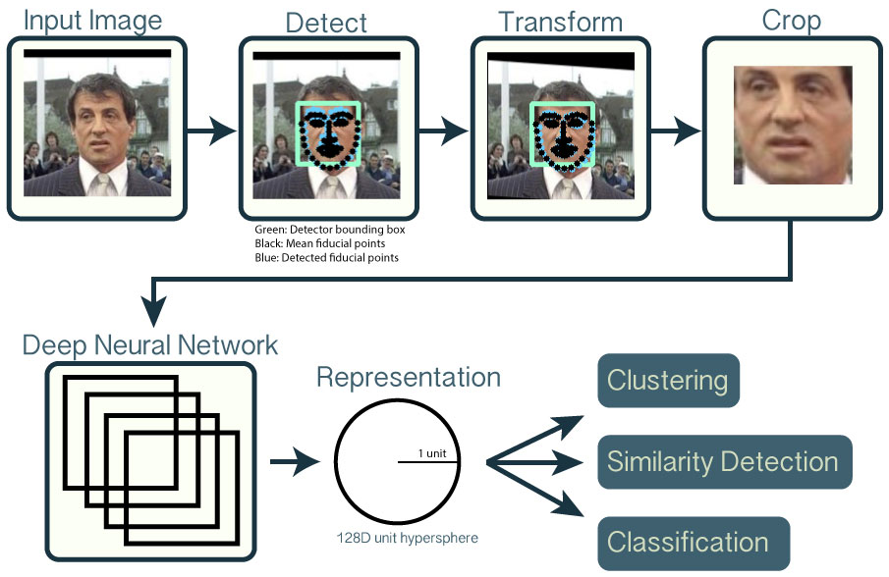
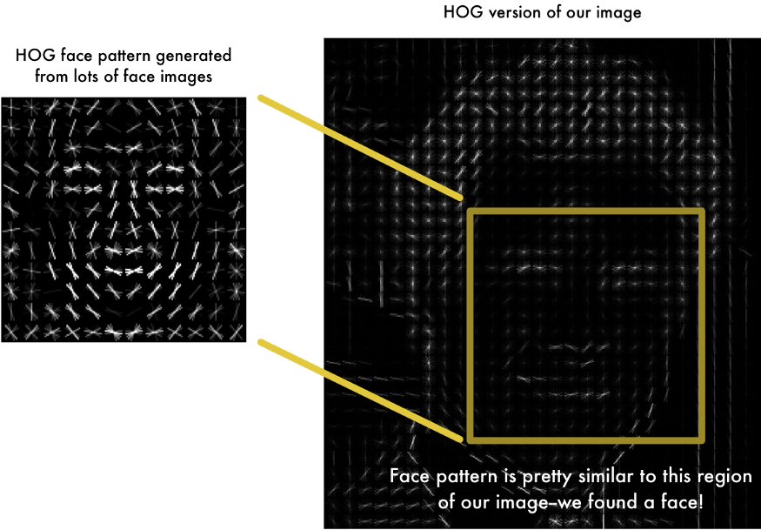
Face Recognition
Photo sources: https://github.com/cmusatyalab/openface/blob/master/images/summary.jpg
https://miro.medium.com/max/875/1*6xgev0r-qn4oR88FrW6fiA.png
Notes:
Theresia

Slide 9

Computer Vision Library - OpenCV
Image Capture & Detection
Google snippets for cv2_imshow() is needed
Load Cascades xml and apply
Draw a rectangle around the face
Cascades
About 6,000 classifiers for a face & thousands of data blocks
Break the detection into 30 to 50 stages
Only go to the further stage for detection if the block pasts the current stage
OpenCV
Video Capture
Via webcam or video files
capture the video frame by frame.
Notes:
Yuxin

Slide 10
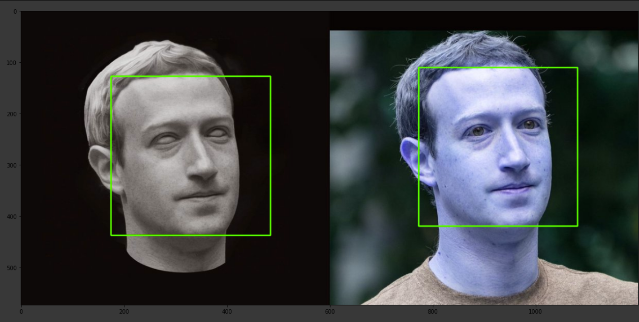
OpenCV Face Detection Result
pupils in real eyes are too small to be distinguished
Photo source: https://twitter.com/barryharryy/status/976483044138897408
Notes:
Yuxin

Slide 11
Computer Vision Library - OpenCV
Image Capture & Detection
Google snippets for cv2_imshow() is needed
Load Cascades xml and apply
Draw a rectangle around the face
Cascades
About 6,000 classifiers for a face & thousands of data blocks
Break the detection into 30 to 50 stages
Only go to the further stage for detection if the block pasts the current stage
OpenCV
Video Capture
Via webcam or video files
capture the video frame by frame.
Notes:
Yuxin

Slide 12
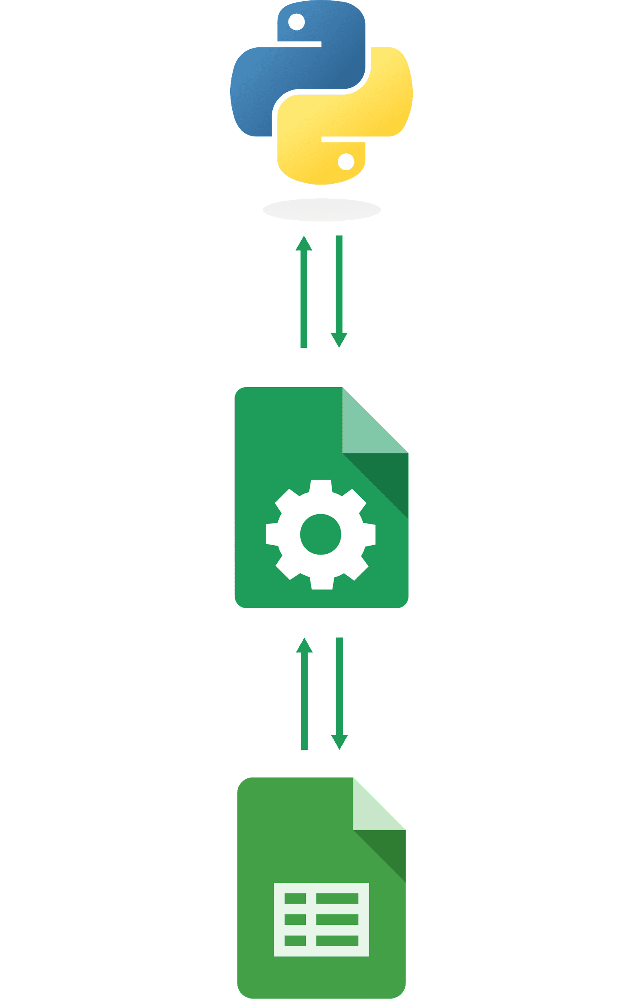
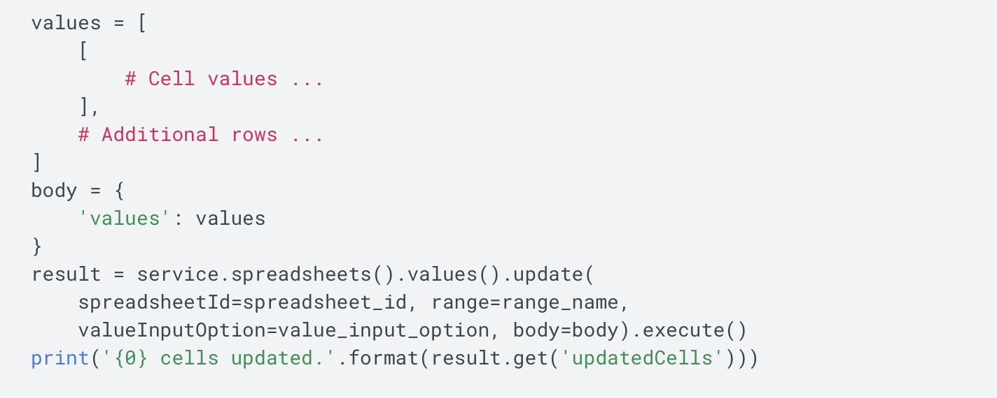
Google Sheets API
Google API library (291 public available)
Authentication and authorization
Wide range of functionalities
Read and write data
Build pivot tables
Apply formulas
Create charts
Photo source: https://sheetsu.com/sheets-python
Notes:
Hsin-Ting

Slide 13
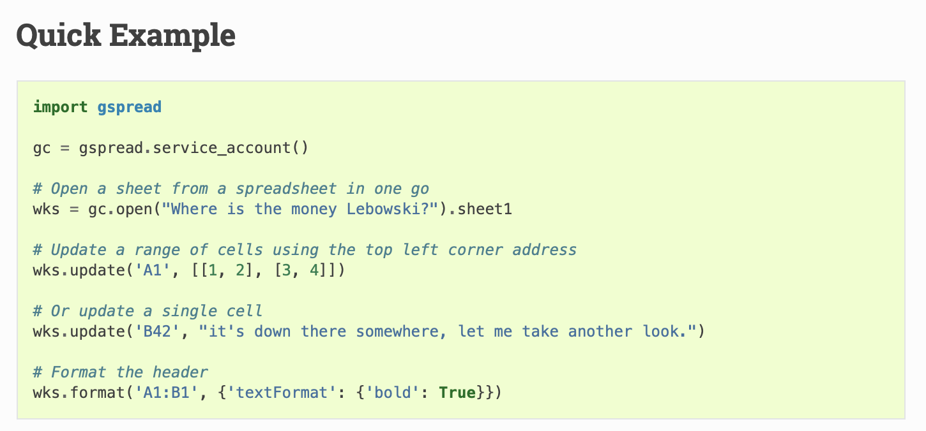
gspread
A Python API for Google Sheets.
Integrate with pandas and Numpy packages
Photo source: https://sheetsu.com/sheets-python
Notes:
Hsin-Ting

Slide 14
Implement-
ation
03
Preparation, training, application, evaluation, deployment
Notes:
Hsin-Ting

Slide 15
UAttended Architecture
Labeled Pictures
Video/
Screenshot
Face recognition model training
Face Recognition
Face Recognition
Applying face recognition model for recognition
Encoding
Encoding
training
Classifier
applying
Predicted Name List
write
Google API
Attendance List
read
Notes:
Hsin-Ting

Slide 16
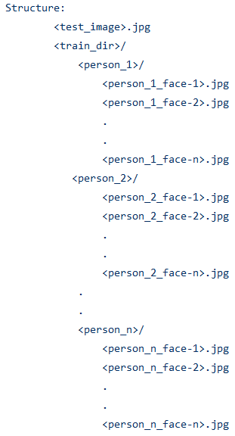
Preparation
Photo source: https://github.com/ageitgey/face_recognition/blob/master/examples/face_recognition_svm.py
Notes:
Theresia

Slide 17
Training Face Recognition Model
Face Encodings
For images portraying only one person
Face Locations
Finding face in image for each person
SVC Classifier
Trained with face encodings and names
Notes:
Theresia

Slide 18
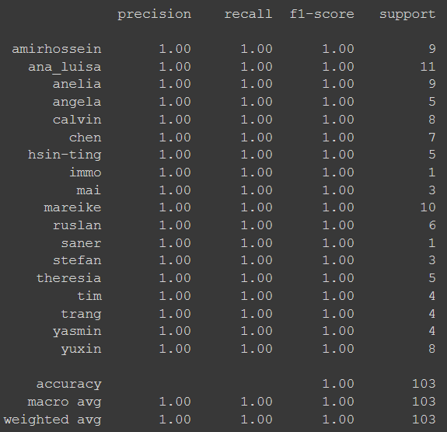
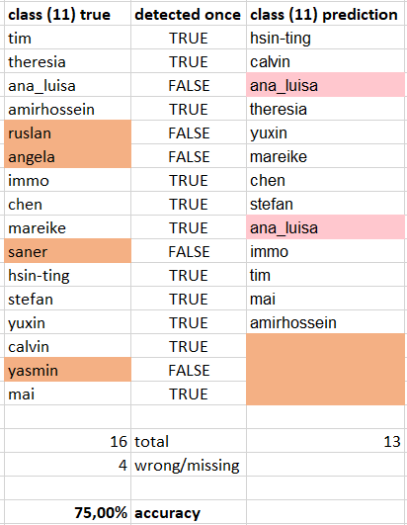
Testing Evaluation
01
Testing with Individual Pictures
02
Random Tests with Class Pictures
88.84 %
100 %
Predictions of all unknown test data of individuals
Classification Report
Prediction of single unknown class picture
Mean accuracy across four examples
Notes:
Theresia

Slide 19
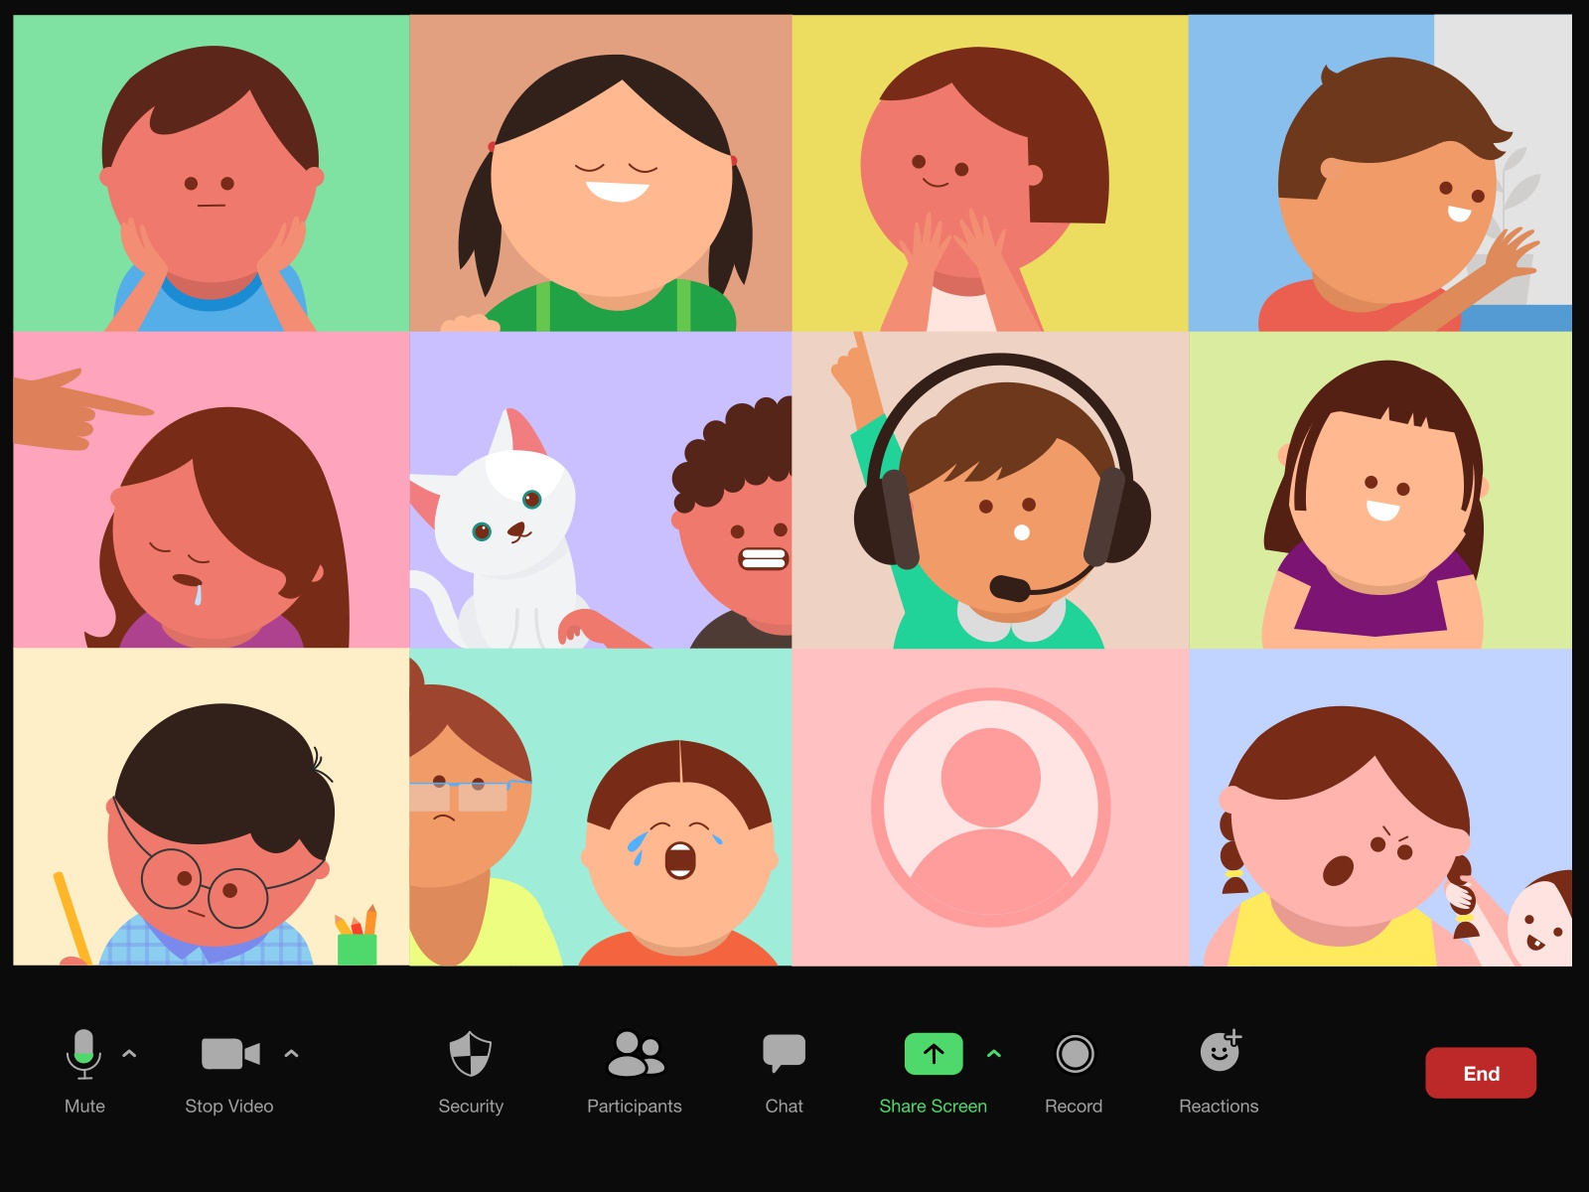
Scenarios
01 Recognize with Screenshot
02 Recognize with Videos/Webcam
Pros: Fast and simple
Cons: need to choose the proper moment in case some students are late
Pros: No interruption during the lecture, can extract more info, not miss late students
Cons: Complicated computation, privacy concern
Photo source: https://www.eyeson.com/
Notes:
Yuxin

Slide 20
Face Recognition Application
Identify potential wrongly recognized faces based on defined threshold
Detect the locations of faces and generate encodings respectively
Face Location & Encoding
Result Evaluation
Image Capture
Face Recognition
Google API Connection
Catch faces based on the uploaded screenshot or video
Apply the classifier model to recognize input faces and generate a name list
Authenticate Google API to connect the result with the attendance list sheet
Notes:
Yuxin

Slide 21
Result Evaluation
01
Recognize with Screenshot
02
Recognize with Videos/Webcam
identify names
that appear more
than once
Calculate the percentage
of names that could be wrongly recognized are calculated
Threshold:
if the frequency of a name(vi)/max(v) <10%
the name could potentially
be wrongly recognized.
Generate a dictionary
{key =name: value = the frequency appearing in all frames}
Number of faces detected: 13
students attended are anelia,saner,calvin,theresia,yuxin,hsin-ting,ruslan,
angela,chen,immo,amirhossein,tim,stefan.
Ops! Someone looks too similar to ana_luisa and was wrongly recognized!
7.6% of faces are recognized duplicately.
running time is 0.008185625076293945.
The frequency of names in all frames are:
yuxin: 63
hsin-ting: 89
theresia 89
ana_luisa: 2
Surely attended students are yuxin,hsin-ting, theresia.
Ops, ana_luisa has very low appearance rate, maybe s/he is someone else!
Notes:
Yuxin

Slide 22
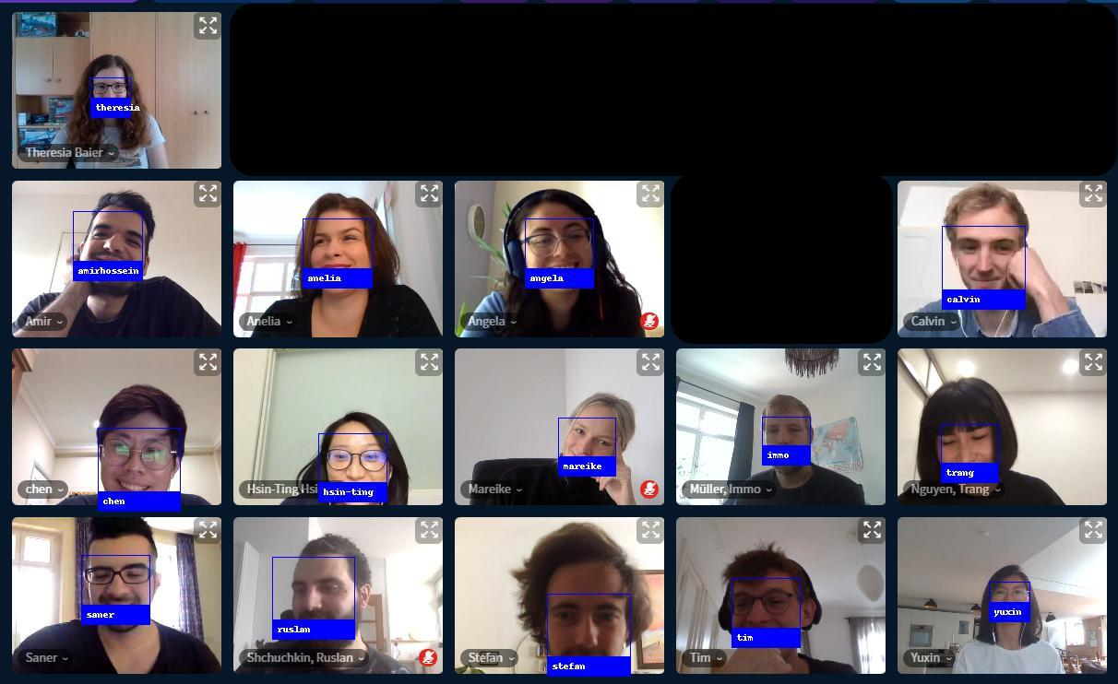
Recognition Result
Notes:
Yuxin

Slide 23
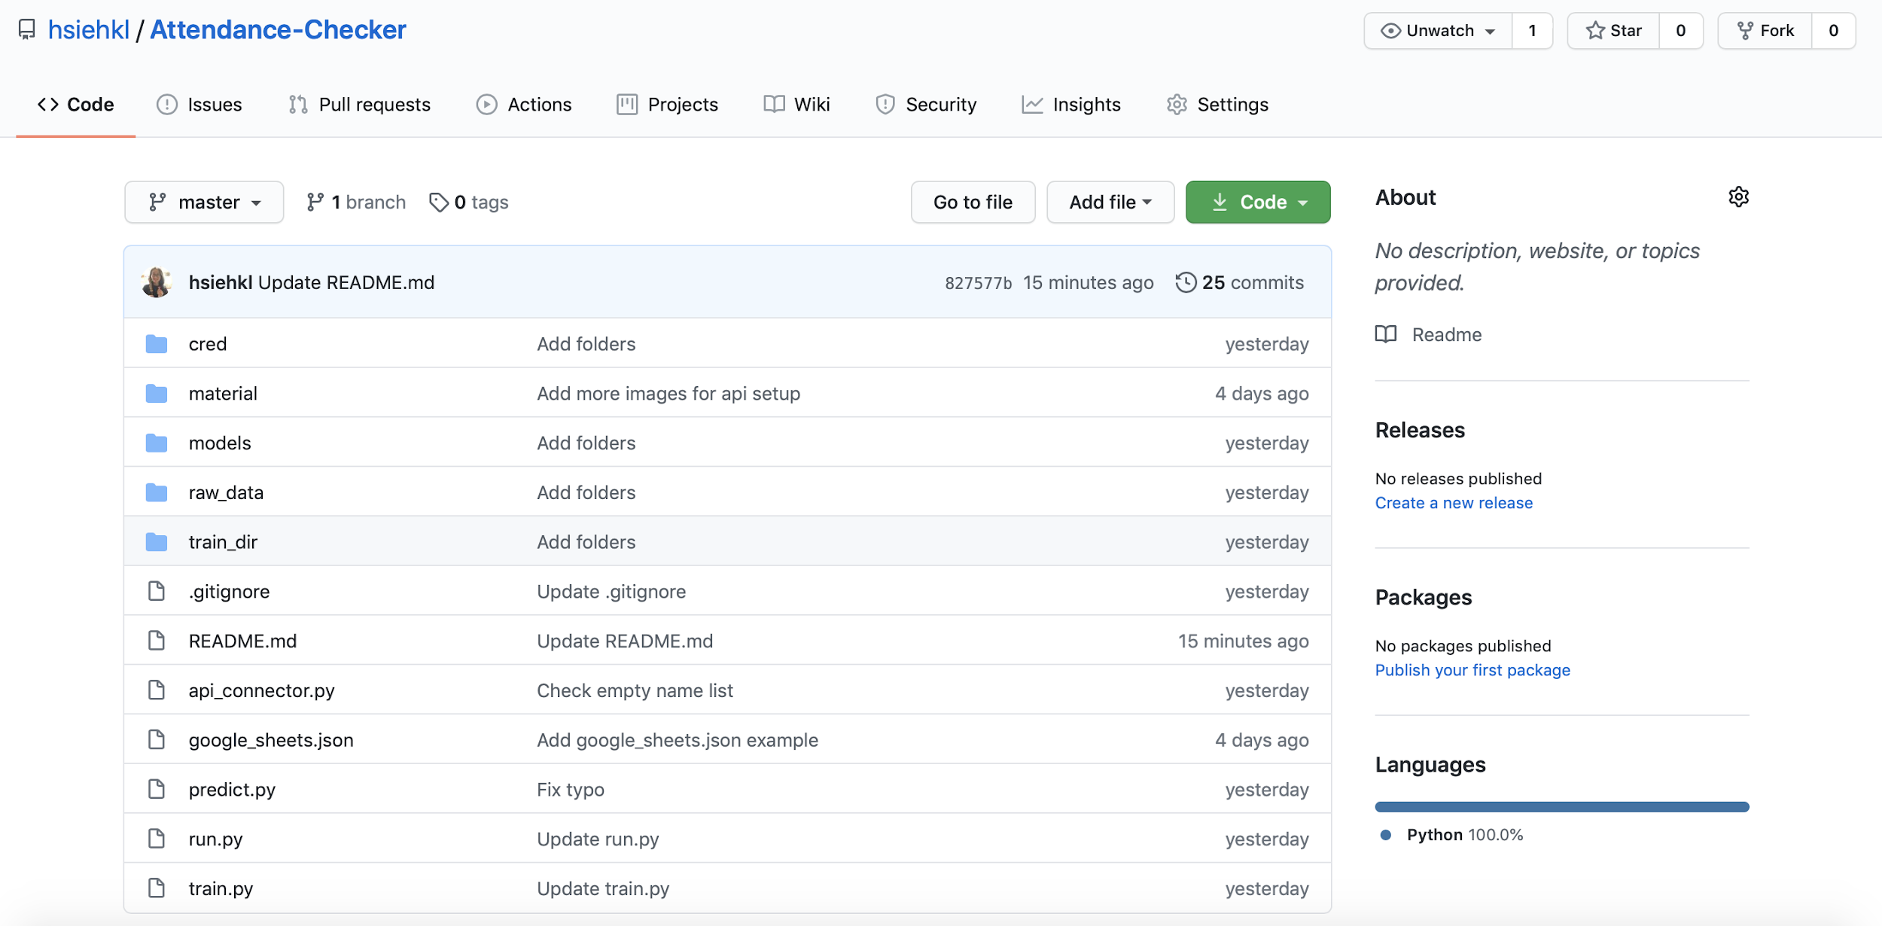
UAttended Deployment on GitHub
Notes:
Hsin-Ting

Slide 24
UAttended Main Components
Labeled Pictures
Video/
Screenshot
Face recognition model training
Face Recognition
Face Recognition
Applying face recognition model for recognition
Encoding
/models -> reusable
Encoding
training
Classifier
applying
train.py
predict.py
Predicted Name List
write
api_connector.py
Google API
Attendance List
read

Slide 25
UAttended Deployment on GitHub
https://github.com/hsiehkl/Attendance-Checker
Notes:
Hsin-Ting

Slide 26
Conclusion & Outlook
04
Summary, reflection & further work
Notes:
Theresia

Slide 27

LET AI DO THE JOB
Notes:
Theresia

Slide 28

Challenges
Adaption To Google Colaboratory
File reading
Display the video and image
Limited GPU memory
Can’t reliably apply CNN model
<100% Accuracy
Fairness
Subtle manual adjustments needed
Unknown faces can’t be recognized as unknown
Data privacy
Dissent of students
Notes:
Theresia

Slide 29
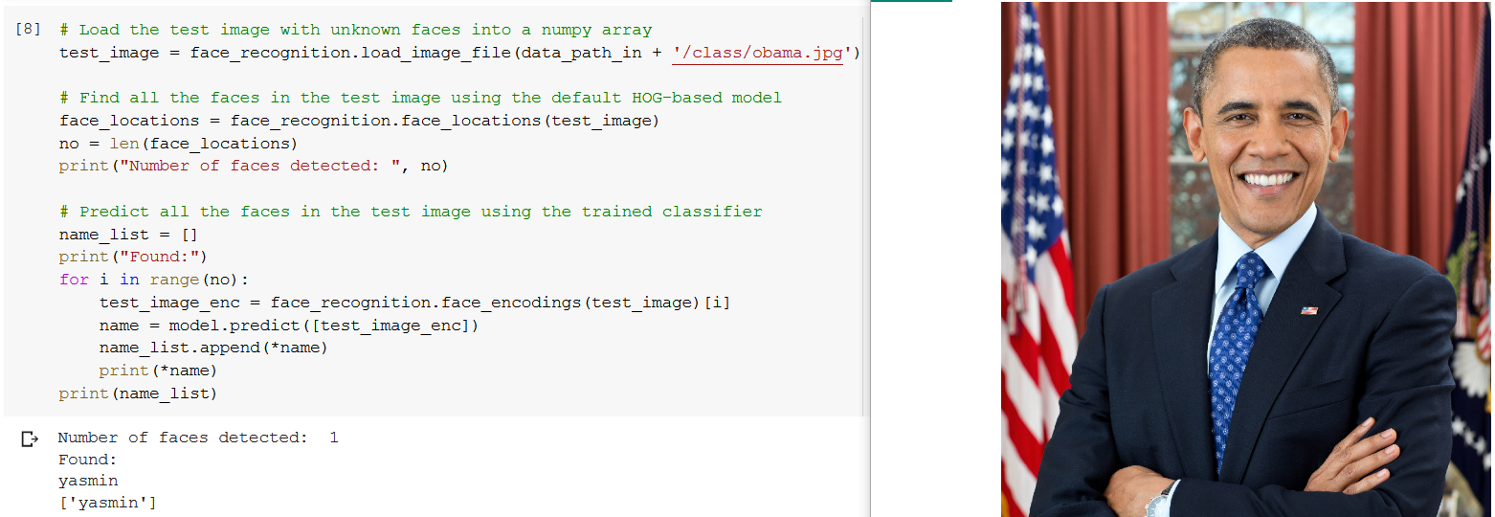
Misclassification
Photo source: https://raw.githubusercontent.com/ageitgey/face_recognition/master/examples/obama.jpg
Notes:
Theresia

Slide 30
Further Work
Get more powerful GPU
Apply CNN face recognition model
Tune classifier model
Reach 100% accuracy rate
More user-friendly
Use the service directly without the necessity to download specific packages
Model Optimization
Frontend
More Functions
Privacy Security
Capture check-in and check-out time
Emotion Analysis
Lecture quality analysis
Strategy and usage rules to ensure the secure environment and privacy protection
Notes:
Theresia

Slide 31
THANKS!
Do you have any questions？
Notes:
Theresia

Slide 32
Sources
Summary of Face Recognition Steps: Amos, B. (2015, September 24). Summary [Digital image]. Retrieved July 27, 2020, from https://github.com/cmusatyalab/openface/blob/master/images/summary.jpg
HOG Face Patterns: [HOG Face Patterns]. (n.d.). Retrieved July 27, 2020, from https://miro.medium.com/max/875/1*6xgev0r-qn4oR88FrW6fiA.png
Folder Structure: Baburajan, A. (2019, December 03). Face_recognition/face_recognition_svm.py at master · ageitgey/face_recognition. Retrieved July 26, 2020, from https://github.com/ageitgey/face_recognition/blob/master/examples/face_recognition_svm.py
Obama: Obama [Digital image]. (n.d.). Retrieved July 26, 2020, from https://raw.githubusercontent.com/ageitgey/face_recognition/master/examples/obama.jpg

